Slide 1
Chapter 5
How to test and debug a JavaScript application

Slide 2
Objectives (part 1)
Applied
Develop test plans for the applications that you develop.
Use Chrome’s developer tools to debug applications by setting breakpoints, viewing the current data values, and stepping through the execution of statements.
Trace the execution of an application with console.log() statements.
View the source code for a web page.
Knowledge
Distinguish between the goals of testing and debugging.
Distinguish between syntax, runtime, and logic errors.
Describe the type of debugging problem that can occur when you use floating-point numbers in arithmetic expressions, and describe one way to fix this problem.

Slide 3
Objectives (part 2)
Describe the type of debugging problem that can occur if you don’t use strict mode and JavaScript treats undeclared variables as global variables.
In general terms, describe how to create a test plan.
Describe the procedure for tracing the execution of an application with console.log() statements.

Slide 4
Testing vs. debugging
The goal of testing - QA - Quality Assurance Testing
To find all errors before the application is put into production.
The goal of debugging
To fix all errors before the application is put into production.
The three types of errors that can occur
Syntax errors - Don’t follow the syntax rules of a language -
Runtime errors - Program is actively running but a part of it isn’t working properly (full HD, full RAM, network connection ins’t made, credentials for DB are incorrect)
Logic errors - Mistakes that the developer makes in solving a problem. Spelling errors, math errors

Slide 5
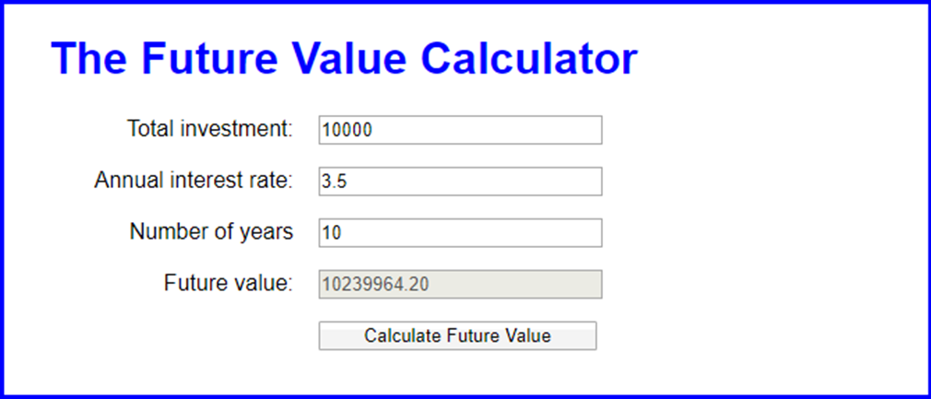
The Future Value application with a logic error

Slide 6
Common syntax errors
Misspelling keywords, like coding querySelecter() instead of querySelector().
Omitting required parentheses, quotation marks, or braces.
Not using the same opening and closing quotation mark.
Omitting the semicolon at the end of a statement.
Misspelling or incorrectly capitalizing an identifier, like defining a variable named salesTax and referring to it later as salestax.

Slide 7
Problems with HTML references
Referring to an attribute value or other HTML component incorrectly, like referring to an id as “salesTax” when the id is “sales_tax”.

Slide 8
Problems with data and comparisons
Not making sure that a user entry is the right data type before processing it.
Not using the parseInt() or parseFloat() method to convert a user entry into a numeric value before processing it.
Using one equal sign instead of two when testing for equality.
if(x==10)

Slide 9
Problems with floating-point arithmetic
The number data type in JavaScript uses floating-point numbers, and that can lead to arithmetic results that are imprecise. For example,
var salesAmount = 74.95;
salesTax = salesAmount * .1;
// result is 7.495000000000001
One way to fix this potential problem is to round the result to the right number of decimal places. If necessary, you can also convert it back to a floating-point number:
salesTax = salesTax.toFixed(2)
// result is 7.50 as a string
salesTax = parseFloat(salesTax.toFixed(2));
// result is 7.50 as a number

Slide 10
Problems with undeclared variables that are treated as global variables
If you don’t use strict mode and you assign a value to a variable that hasn’t been declared, the JavaScript engine treats it as a global variable, as in this example:
const calculateTax = function(subtotal, taxRate) {
let salesTax = subtotal * taxRate;
// salesTax is local
salestax = parseFloat(salesTax.toFixed(2));
// salestax is global
return salesTax;
// salesTax isn't rounded but salestax is
};
The solution to this type of problem is to always use strict mode.

Slide 11
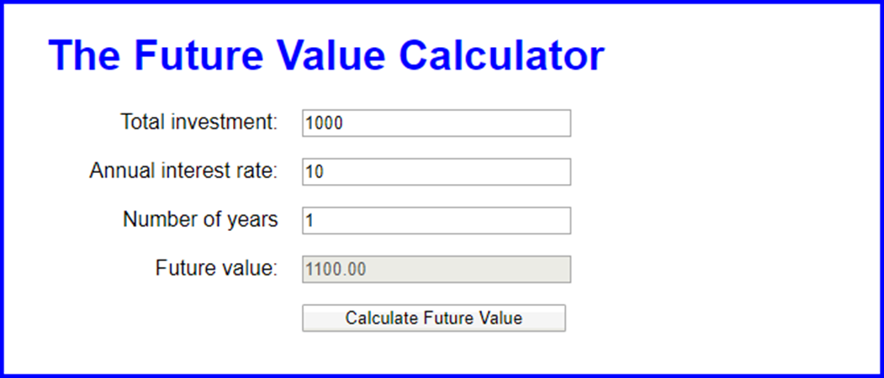
The Future Value application with valid data

Slide 12
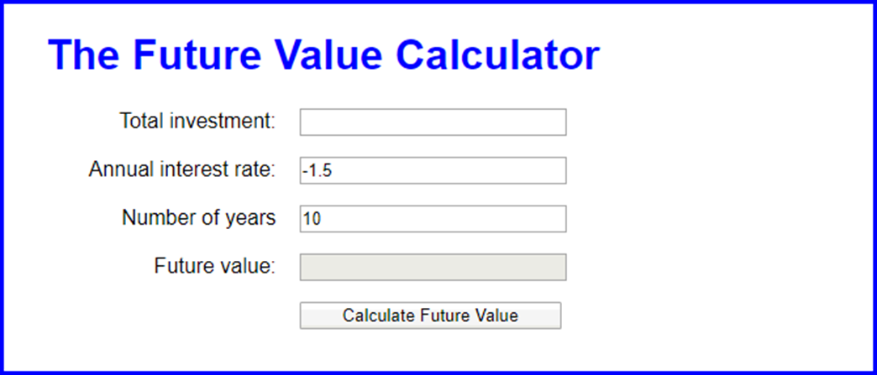
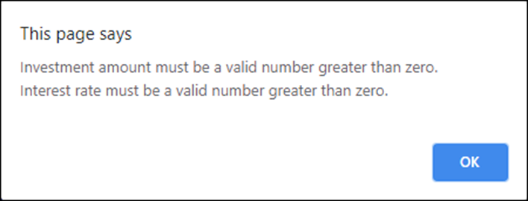
The Future Value application with invalid data

Slide 13
The two critical test phases
Test the application with valid input data to make sure the results are correct.
Test the application with invalid data or unexpected user actions. Try everything you can think of to make the application fail.
How to make a test plan for the critical phases
List the valid entries that you’re going to make and the correct results for each set of entries. Then, make sure that the results are correct when you test with these entries.
List the invalid entries that you’re going to make. These should include entries that test the limits of the allowable values.

Slide 14
Two common testing problems
Not testing a wide enough range of entries.
Not knowing what the results of each set of entries should be and assuming that the results are correct because they look correct.

Slide 15
Terms related to testing and debugging
test
debug
bug
syntax error
runtime error
logic error
throw an exception - An exception is an object that is generated when a problem occurs that can crash your software.
throw an error - Is a problem that can be fixed with if/else and loops.
while(num < 0)
//prompt the user for the number again.

Slide 16
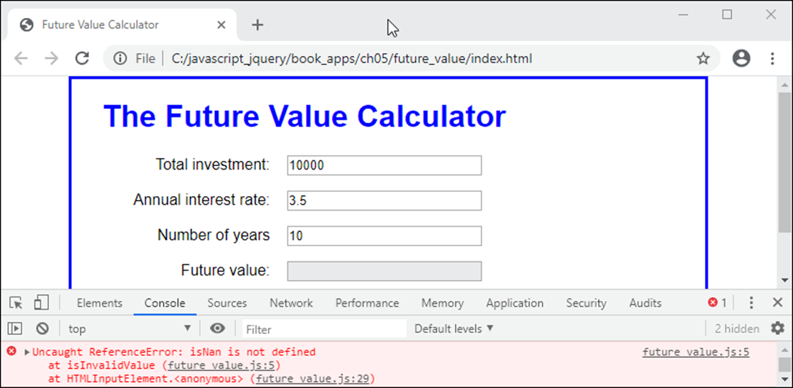
Chrome with an open Console panel that shows an error

Slide 17
Three ways to open Chrome’s developer tools
Press F12
Press Ctrl+Shift+I
Click on the Menu button in the upper right corner of the browser, and select More Tools🡪Developer Tools.
Two ways to close Chrome’s developer tools
Click on the X in the upper right corner of the tools panel
Press F12.

Slide 18
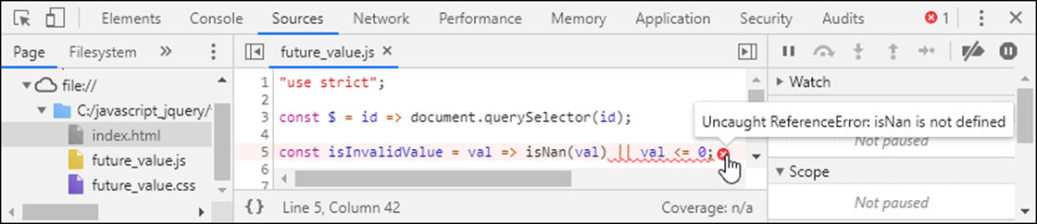
The Sources panel after the link in the Console panel has been clicked
How to find the statement that caused the error
Open the Console panel by clicking on the Console tab. You should see an error message along with the line of code that caused the error.
Click on the link to the right of the error message that indicates the line of code. That will open the Sources panel and display the code that contains the statement with the statement highlighted.
Hover your cursor over the red x to see more information about the error.

Slide 19
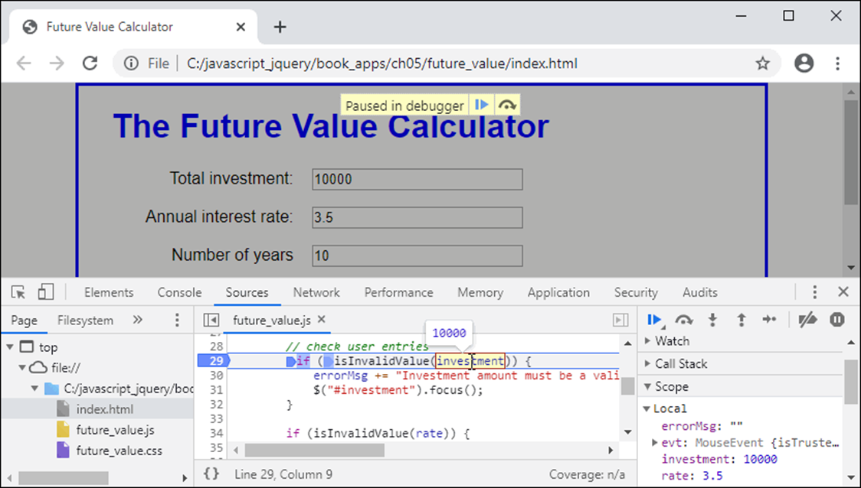
A breakpoint in the Sources panel

Slide 20
How to set or remove a breakpoint
Click on the Sources tab to display the Sources panel. Then, click on the JavaScript file in the left pane (the File Navigator pane) that you want to debug.
In the center pane the Code Editor pane, click on a line number in the bar to the left of a statement. This will add a breakpoint or remove an existing one.

Slide 21
The buttons and keys for stepping through the JavaScript code
Button Key Description
Step Into F11 Step through the code one line at a time.
Step Over F10 Run any called functions without stepping through them.
Step Out Shift+F11 Execute the rest of a function without stepping through it.
Resume F8 Resume normal execution.

Slide 22
How to view the current data values at each step
Hover the mouse pointer over a variable or constant name in the Code Editor pane.
View the current values in the Local section of the right pane (the Debugging pane).
Click the ► symbol in the Watch section of the Debugging pane, click the plus sign that appears, and type the variable or constant name or expression that you want to watch.
The values are also displayed to the right of the declarations in the Code Editor pane.

Slide 23
Terms related to developer tools
developer tools
F12 tools
breakpoint
step through code

Slide 24
One method of the console property of the window object
log(string)
Code with two log() methods that trace its execution
const calculateFV = (investment, rate, years) => {
console.log("calculateFV function has started");
let futureValue = investment;
for (let i = 1; i < years; i++ ) {
futureValue += futureValue * rate / 100;
console.log(
`i = ${i}: future value = ${futureValue}`);
}
return futureValue;
};

Slide 25
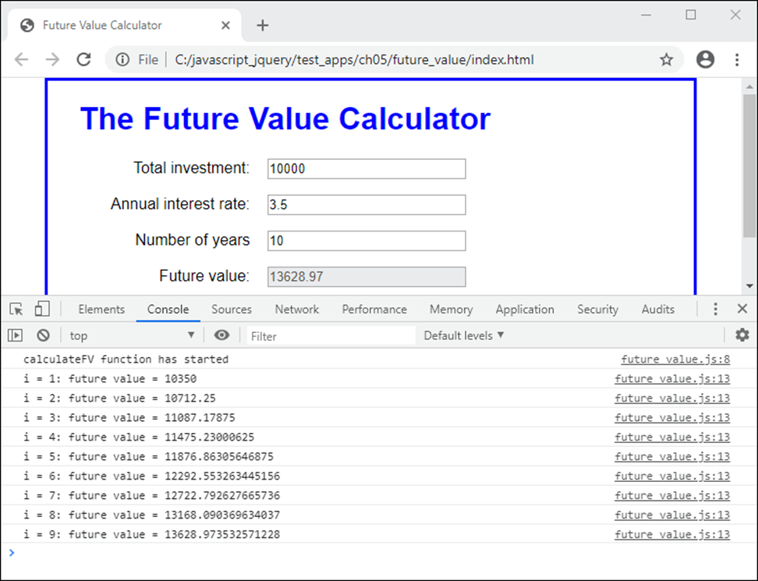
The log messages in the Console panel of Chrome’s developer tools

Slide 26
Three more methods of the console property of the window object
warn(string)
error(string)
trace()
Code that sends error and warning messages to the Console panel
const isInvalidValue = val => {
if (isNaN(val)) {
console.error("Value is not a number");
} else if (val <= 0) {
console.warn(
`Value ${val} is not greater than zero.`);
}
return isNaN(val) || val <= 0
};

Slide 27
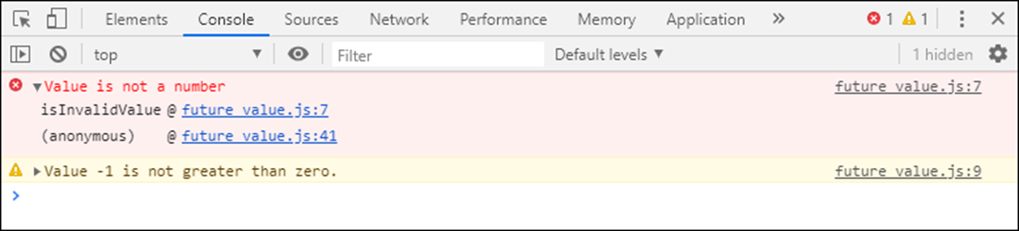
How the error and warning messages look in the Console panel

Slide 28
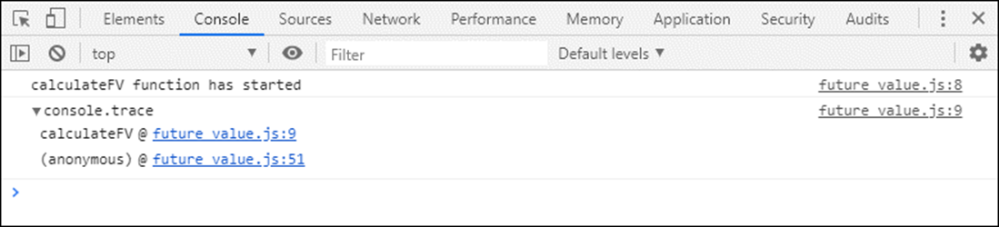
Code that sends a stack trace to the Console panel
const calculateFV = (investment, rate, years) => {
console.log("calculateFV function has started");
console.trace();
// rest of code
};
How the stack trace looks in the Console panel

Slide 29
Terms related to tracing
trace execution
stack trace

Slide 30
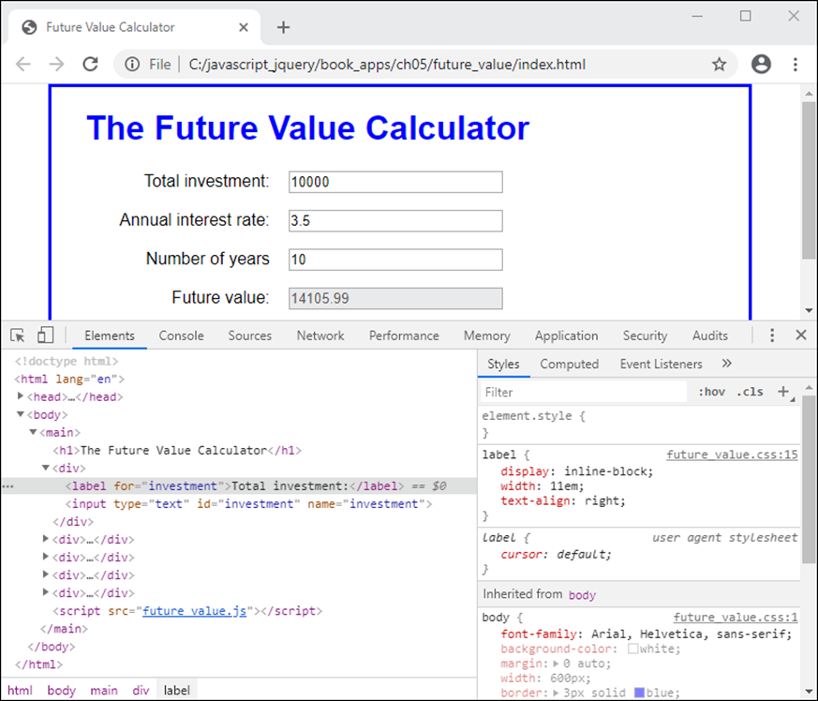
The HTML and CSS for a web page in the Elements panel

Slide 31
How to view the source code for a web page using the developer tools
Open the developer tools and then click on the Elements tab to display the Elements panel. This panel displays the HTML nodes for a document.
Expand the nodes until you can see the HTML element you’re looking for.
If your JavaScript code changes the DOM, such as by adding or removing nodes, the changes show in the Elements panel as well.
To select a node, click on it. Then, you can see the CSS that’s applied to the element in the Styles pane at the right side of the panel.

Slide 32
How to view the source code for a web page using the browser
Right-click the page in the browser and select the View page source command.
To view the code in an external CSS file, click on the link for that file.
When you view the HTML and CSS this way, you won’t see any changes made by your JavaScript code.

